Slide 1
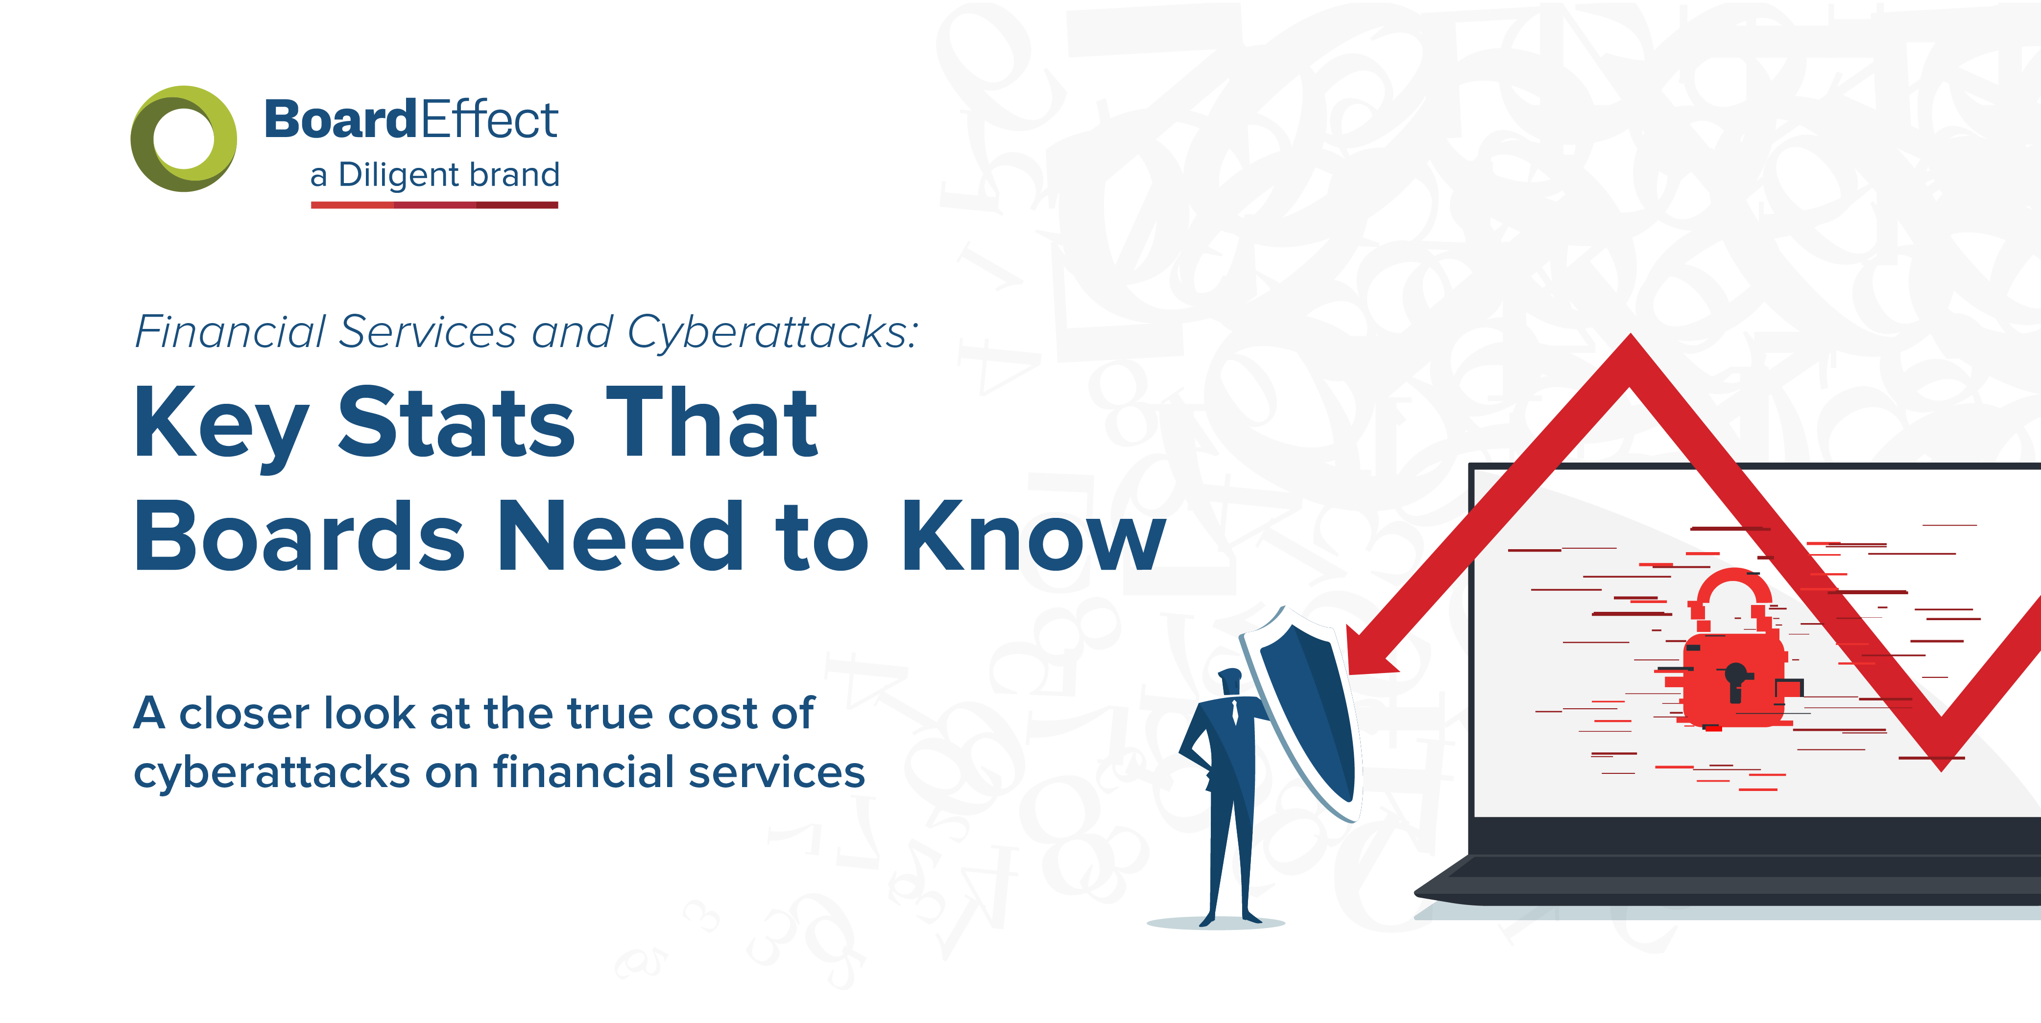
Financial Services and Cyberattacks

Slide 2
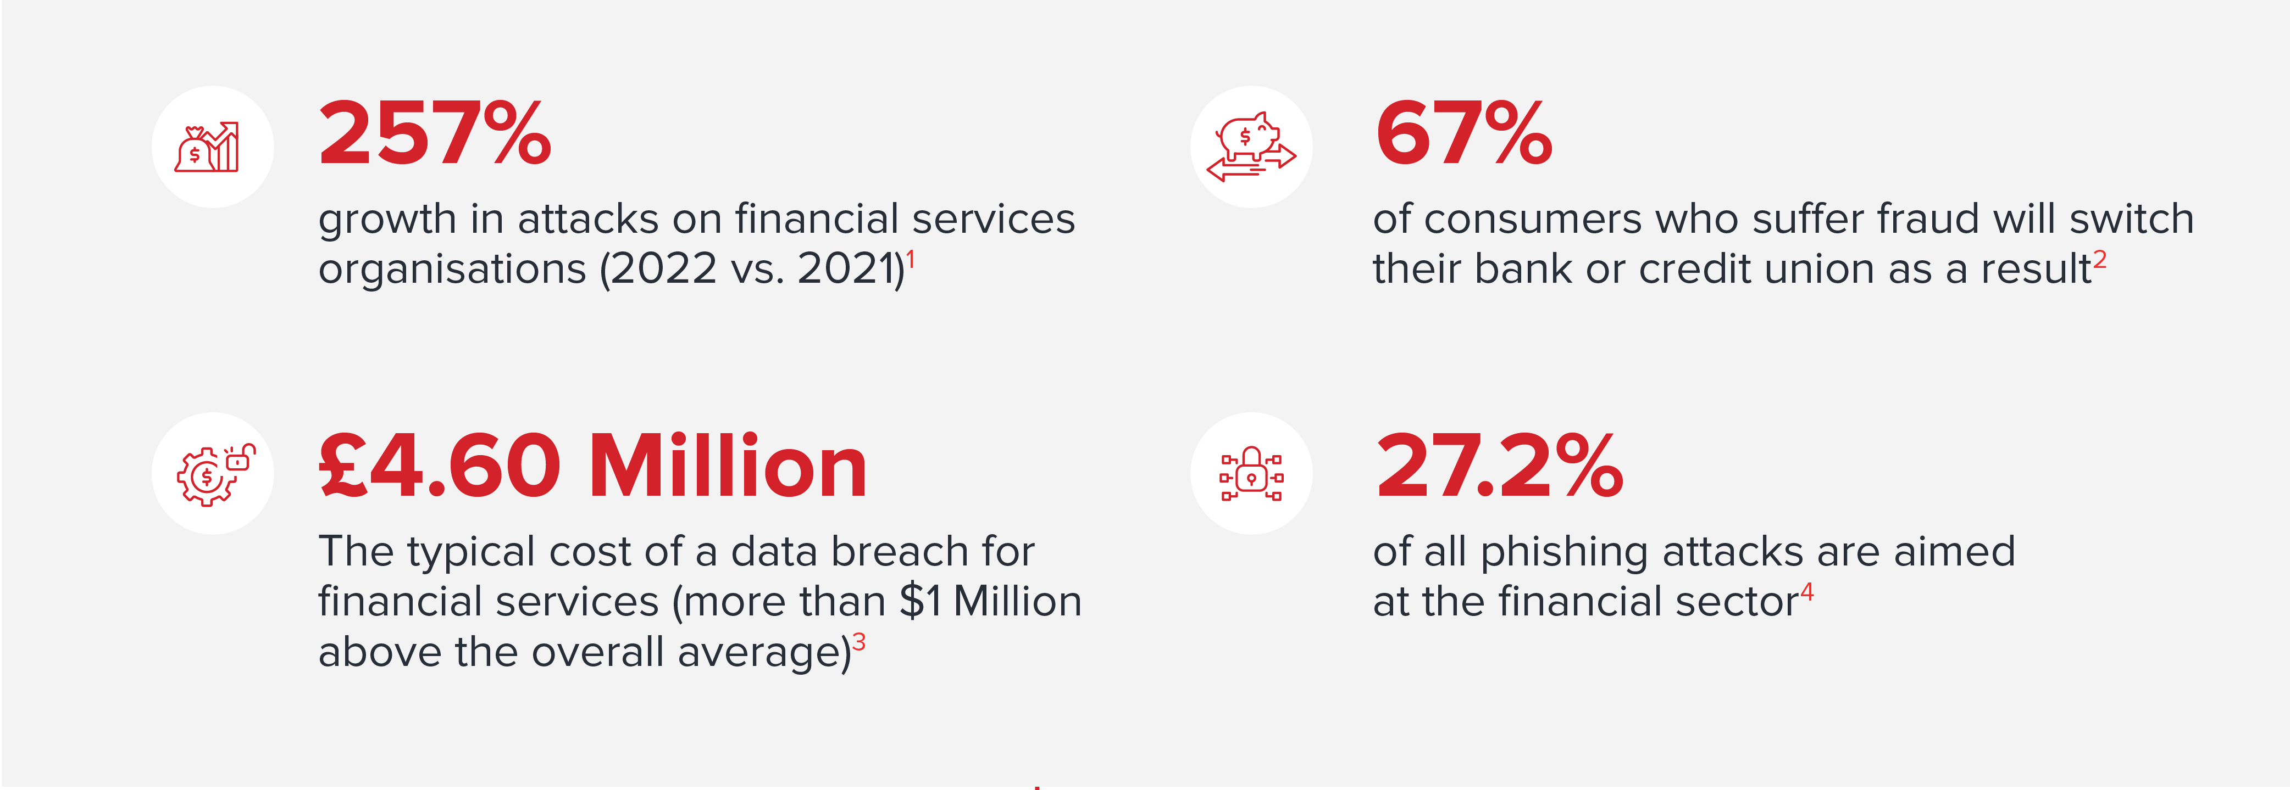
Financial Services and Cyberattacks

Slide 3
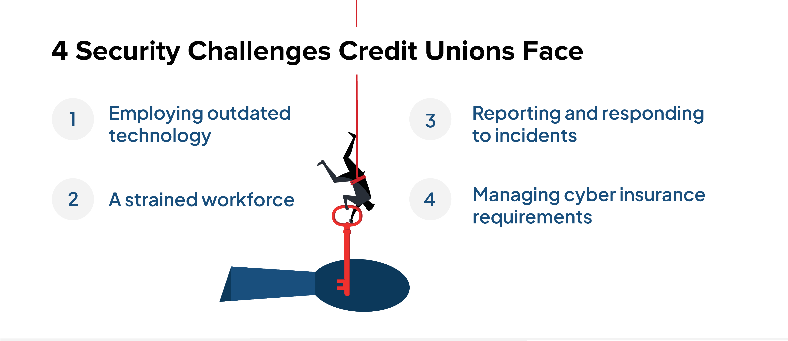
Financial Services and Cyberattacks

Slide 4
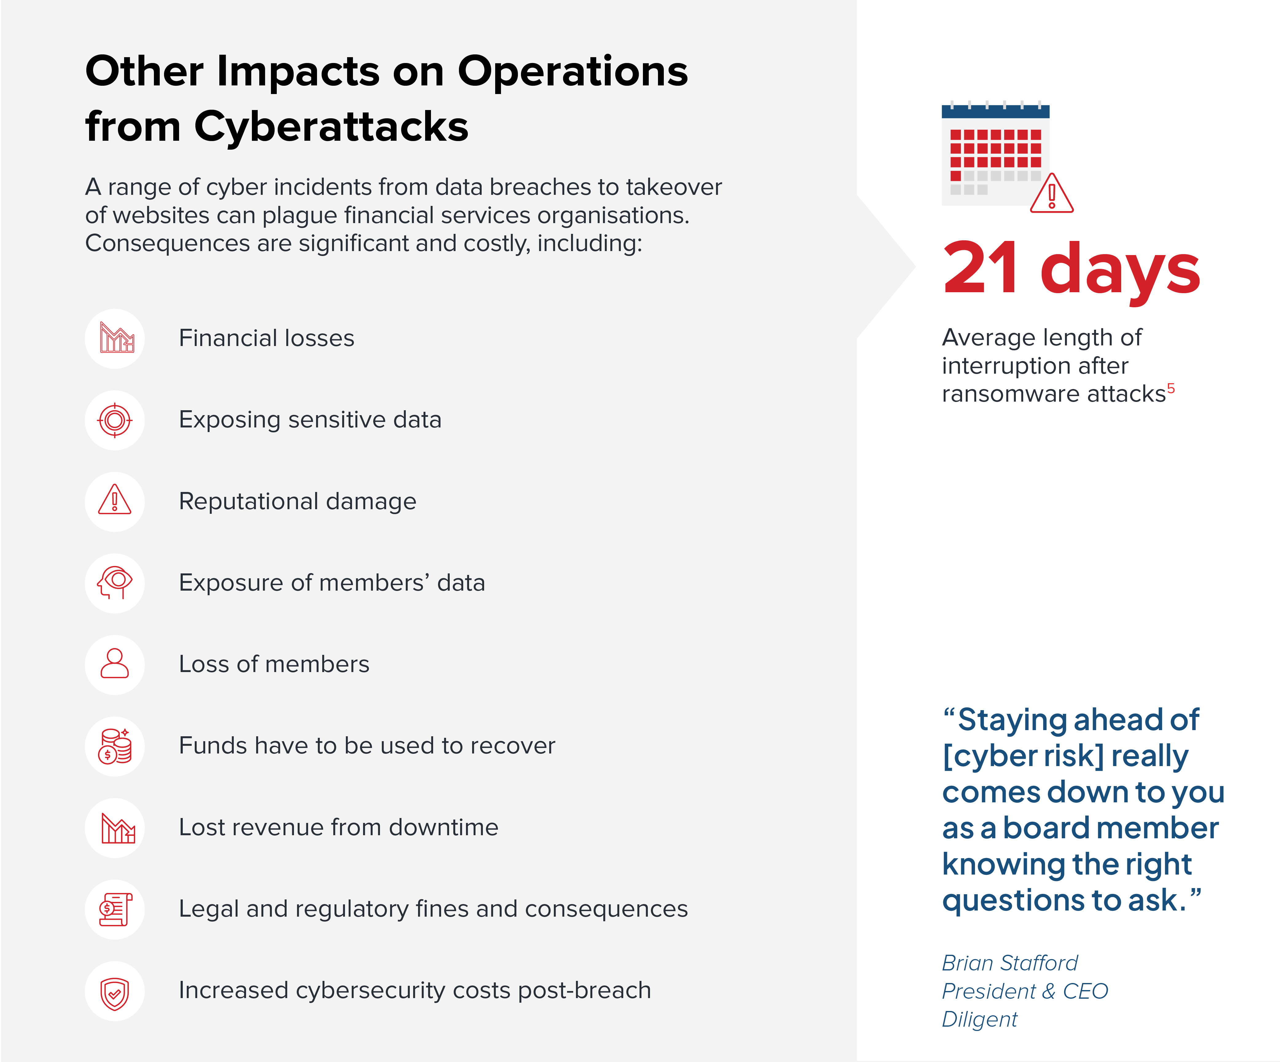
Financial Services and Cyberattacks

Slide 5
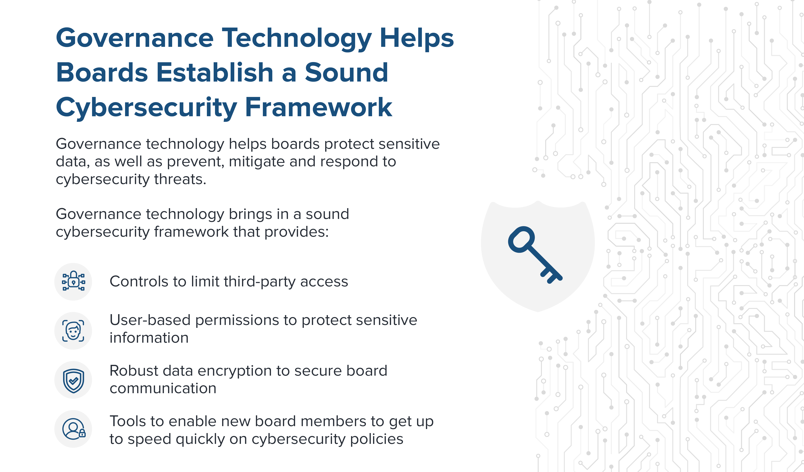
Financial Services and Cyberattacks

Slide 6
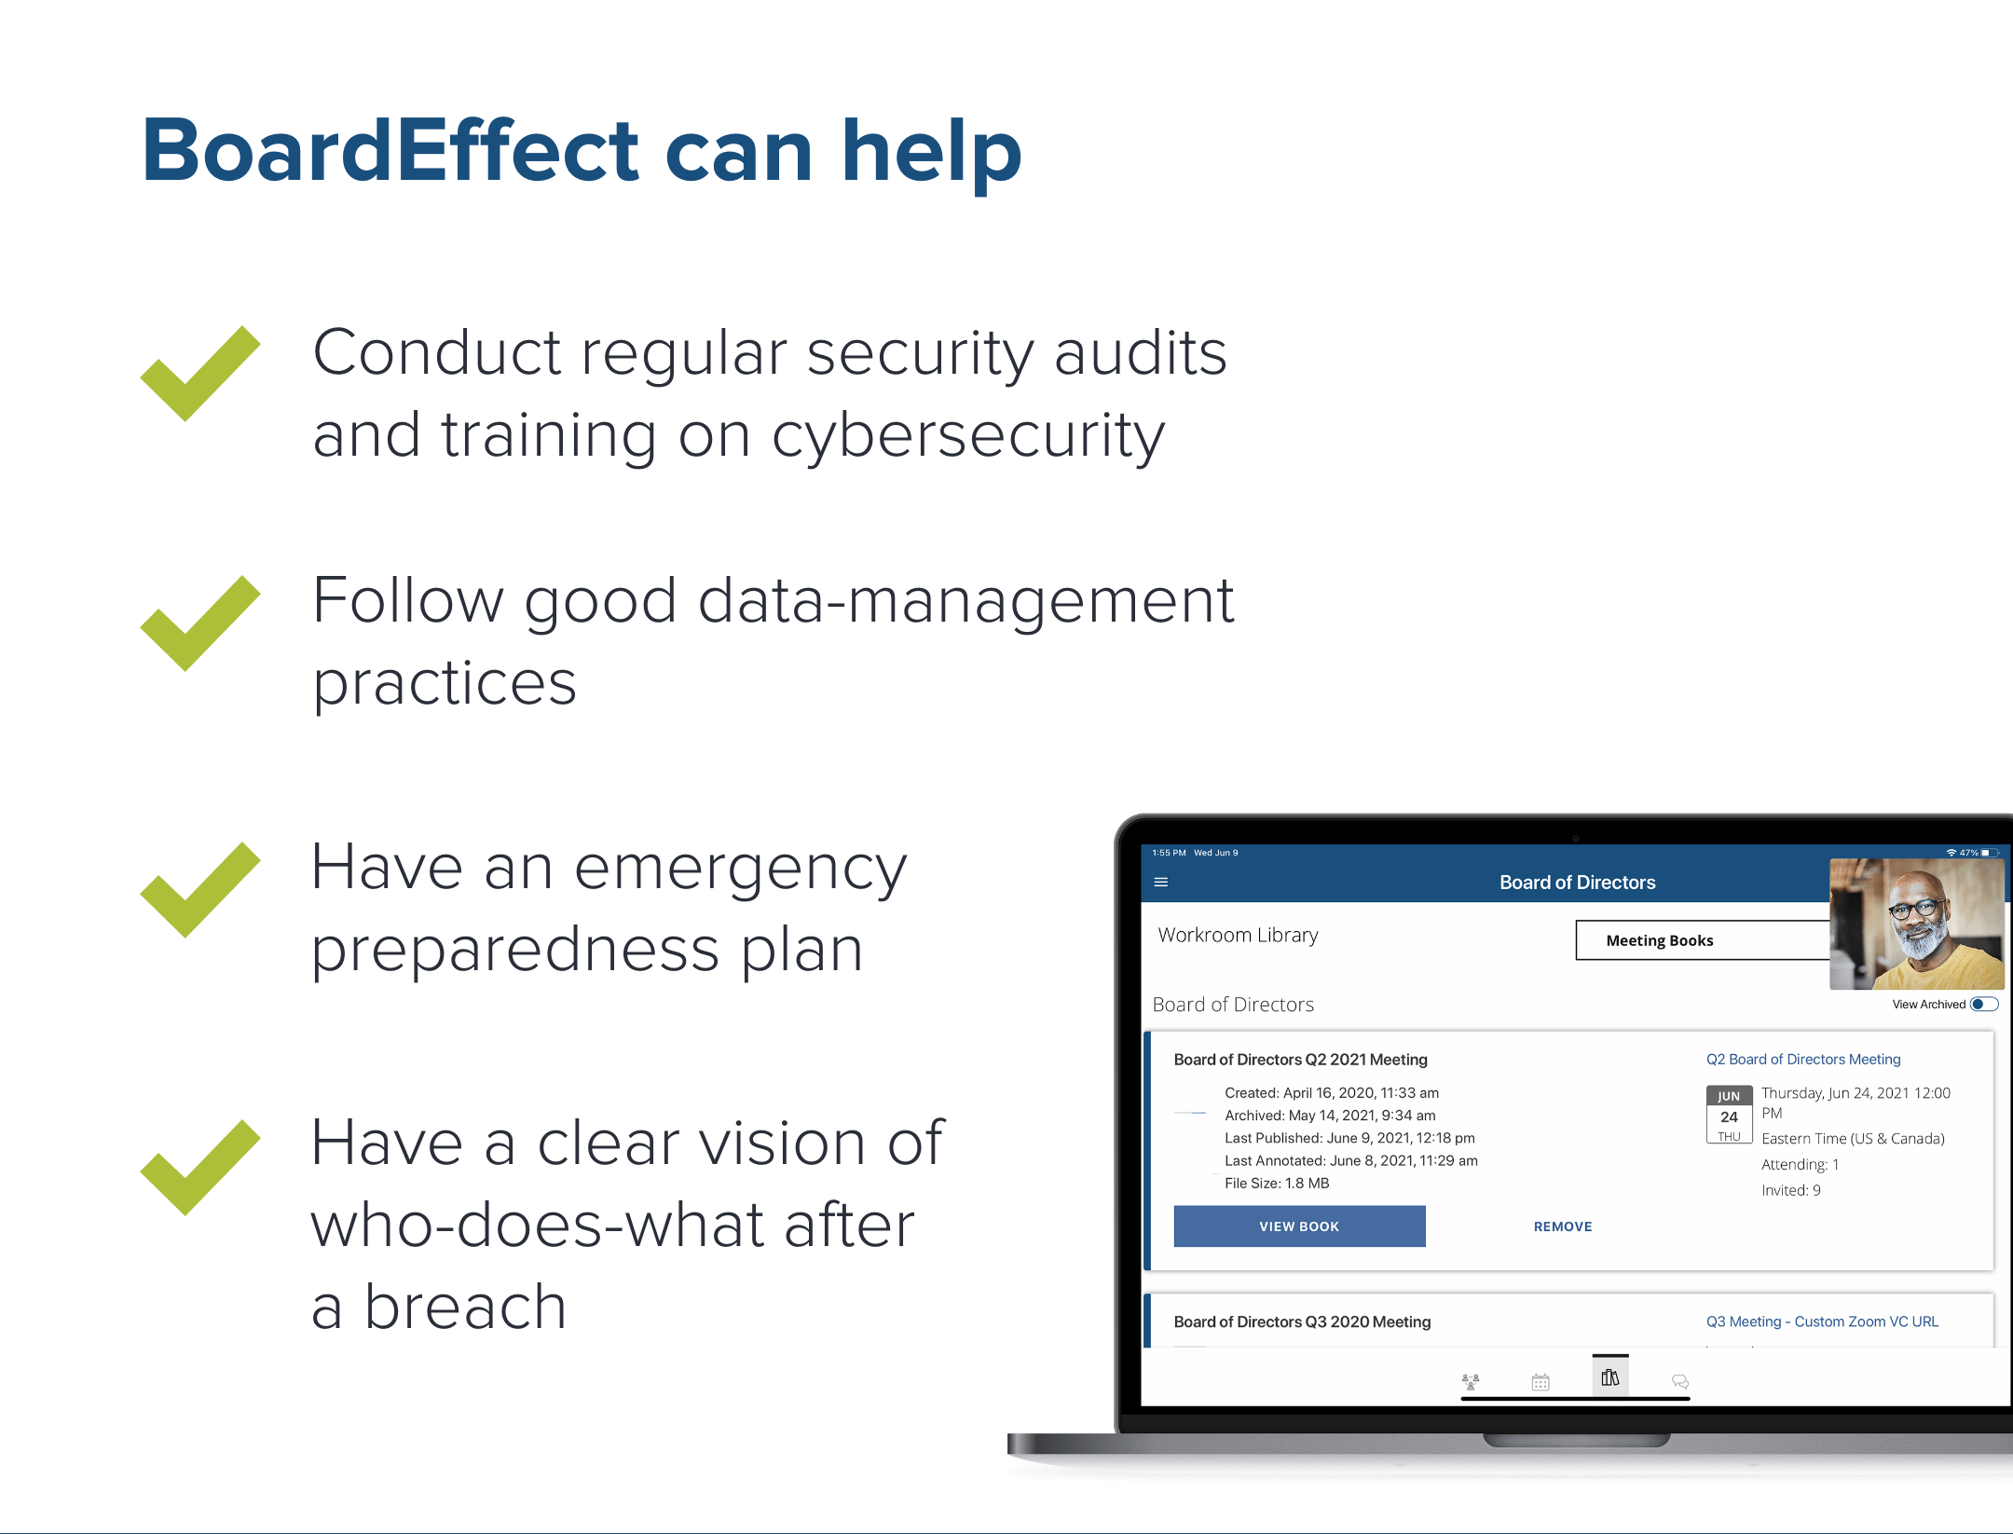
Financial Services and Cyberattacks

Slide 7




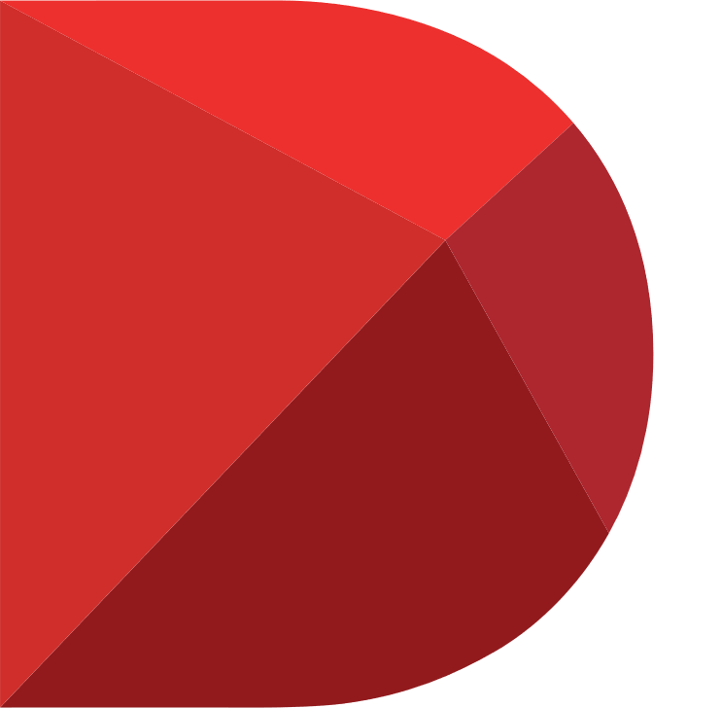

BoardEffect is the trusted board management solution
Intuitive and flexible board management solution
180,000+ users and 5,000 organizations globally
Best-in-class security
80% of customers are nonprofits
Backed by Diligent, the global leader in modern governance

